Slide 1
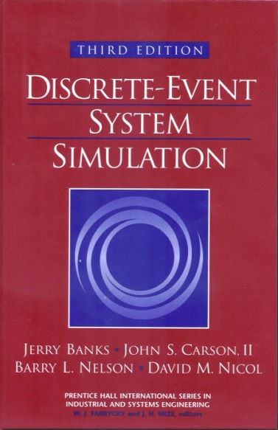
DISCRETE-EVENT SYSTEM SIMULATION
Third Edition
Jerry Banks ∙ John S. Carson II
Barry L. Nelson ∙ David M. Nicol

Slide 2
Part I. Introduction to Discrete-Event System Simulation
Ch.1 Introduction to Simulation
Ch.2 Simulation Examples
Ch.3 General Principles
Ch.4 Simulation Software

Slide 3
Ch. 1 Introduction to Simulation
Real-world process
A set of assumptions
Modeling & Analysis
concerning the behavior of a system
Simulation
the imitation of the operation of a real-world process or system over time
to develop a set of assumptions of mathematical, logical, and symbolic relationship between the entities of interest, of the system.
to estimate the measures of performance of the system with the simulation-generated data
Simulation modeling can be used
as an analysis tool for predicting the effect of changes to existing systems
as a design tool to predict the performance of new systems
Notes:
‹#›

Slide 4
1.1 When Simulation is the Appropriate Tool (1)
Simulation enables the study of, and experimentation with, the internal interactions of a complex system, or of a subsystem within a complex system.
Informational, organizational, and environmental changes can be simulated, and the effect of these alterations on the model’s behavior can be observed.
The knowledge gained in designing a simulation model may be of great value toward suggesting improvement in the system under investigation.
By changing simulation inputs and observing the resulting outputs, valuable insight may be obtained into which variables are most important and how variables interact.
Simulation can be used as a pedagogical device to reinforce analytic solution methodologies.

Slide 5
1.1 When Simulation is the Appropriate Tool (2)
Simulation can be used to experiment with new designs or policies prior to implementation, so as to prepare for what may happen.
Simulation can be used to verify analytic solutions.
By simulating different capabilities for a machine, requirements can be determined.
Simulation models designed for training allow learning without the cost and disruption of on-the-job learning.
Animation shows a system in simulated operation so that the plan can be visualized.
The modern system (factory, wafer fabrication plant, service organization, etc.) is so complex that the interactions can be treated only through simulation.

Slide 6
1.2 When Simulation is not Appropriate
When the problem can be solved using common sense.
When the problem can be solved analytically.
When it is easier to perform direct experiments.
When the simulation costs exceed the savings.
When the resources or time are not available.
When system behavior is too complex or can’t be defined.
When there isn’t the ability to verify and validate the model.

Slide 7
1.3 Advantages and Disadvantages of Simulation (1)
Advantages
New polices, operating procedures, decision rules, information flows, organizational procedures, and so on can be explored without disrupting ongoing operations of the real system.
New hardware designs, physical layouts, transportation systems, and so on, can be tested without committing resources for their acquisition.
Hypotheses about how or why certain phenomena occur can be tested for feasibility.
Insight can be obtained about the interaction of variables.
Insight can be obtained about the importance of variables to the performance of the system.
Bottleneck analysis can be performed indicating where work-in-process, information, materials, and so on are being excessively delayed.
A simulation study can help in understanding how the system operates rather than how individuals think the system operates.
“What-if” questions can be answered. This is particularly useful in the design of new system.

Slide 8
1.3 Advantages and Disadvantages of Simulation (2)
Disadvantages
Model building requires special training. It is an art that is learned over time and through experience. Furthermore, if two models are constructed by two competent individuals, they may have similarities, but it is highly unlikely that they will be the same.
Simulation results may be difficult to interpret. Since most simulation outputs are essentially random variables (they are usually based on random inputs), it may be hard to determine whether an observation is a result of system interrelationships or randomness.
Simulation modeling and analysis can be time consuming and expensive. Skimping on resources for modeling and analysis may result in a simulation model or analysis that is not sufficient for the task.
Simulation is used in some cases when an analytical solution is possible, or even preferable, as discussed in Section 1.2. This might be particularly true in the simulation of some waiting lines where closed-form queueing models are available.

Slide 9
1.4 Areas of Application (1)
WSC(Winter Simulation Conference) : http://www.wintersim.org
Manufacturing Applications
Analysis of electronics assembly operations
Design and evaluation of a selective assembly station for high-precision scroll compressor shells
Comparison of dispatching rules for semiconductor manufacturing using large-facility models
Evaluation of cluster tool throughput for thin-film head production
Determining optimal lot size for a semiconductor back-end factory
Optimization of cycle time and utilization in semiconductor test manufacturing
Analysis of storage and retrieval strategies in a warehouse
Investigation of dynamics in a service-oriented supply chain
Model for an Army chemical munitions disposal facility
Semiconductor Manufacturing
Comparison of dispatching rules using large-facility models
The corrupting influence of variability
A new lot-release rule for wafer fabs

Slide 10
1.4 Areas of Application (2)
Assessment of potential gains in productivity due to proactive reticle management
Comparison of a 200-mm and 300-mm X-ray lithography cell
Capacity planning with time constraints between operations
300-mm logistic system risk reduction
Construction Engineering
Construction of a dam embankment
Trenchless renewal of underground urban infrastructures
Activity scheduling in a dynamic, multiproject setting
Investigation of the structural steel erection process
Special-purpose template for utility tunnel construction
Military Application
Modeling leadership effects and recruit type in an Army recruiting station
Design and test of an intelligent controller for autonomous underwater vehicles
Modeling military requirements for nonwarfighting operations
Multitrajectory performance for varying scenario sizes
Using adaptive agent in U.S Air Force pilot retention

Slide 11
1.4 Areas of Application (3)
Logistics, Transportation, and Distribution Applications
Evaluating the potential benefits of a rail-traffic planning algorithm
Evaluating strategies to improve railroad performance
Parametric modeling in rail-capacity planning
Analysis of passenger flows in an airport terminal
Proactive flight-schedule evaluation
Logistics issues in autonomous food production systems for extended-duration space exploration
Sizing industrial rail-car fleets
Product distribution in the newspaper industry
Design of a toll plaza
Choosing between rental-car locations
Quick-response replenishment

Slide 12
1.4 Areas of Application (4)
Business Process Simulation
Impact of connection bank redesign on airport gate assignment
Product development program planning
Reconciliation of business and systems modeling
Personnel forecasting and strategic workforce planning
Human Systems
Modeling human performance in complex systems
Studying the human element in air traffic control

Slide 13
1.5 Systems and System Environment
System
defined as a group of objects that are joined together in some regular interaction or interdependence toward the accomplishment of some purpose.
System Environment
changes occurring outside the system.
The decision on the boundary between the system and its environment may depend on the purpose of the study.

Slide 14
1.6 Components of a System (1)
Entity : an object of interest in the system.
Attribute : a property of an entity.
Activity : a time period of specified length.
State : the collection of variables necessary to describe the
system at any time, relative to the objectives of the
study.
Event : an instantaneous occurrence that may change the
state of the system.
Endogenous : to describe activities and events occurring
within a system.
Exogenous : to describe activities and events in an
environment that affect the system.

Slide 15
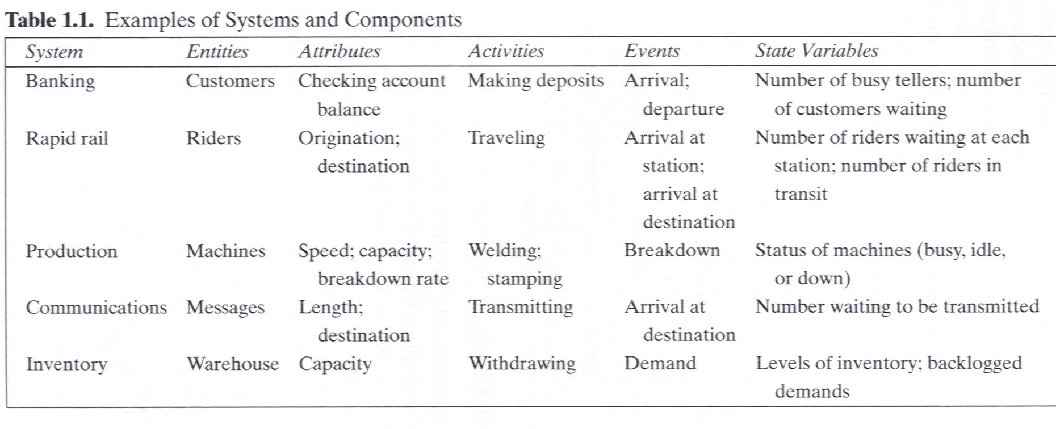
1.6 Components of a System (2)

Slide 16
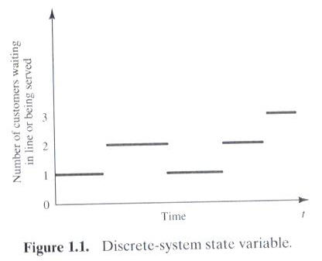
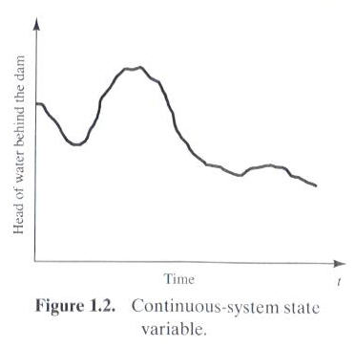
1.7 Discrete and Continuous Systems
Systems can be categorized as discrete or continuous.
Bank : a discrete system
The head of water behind a dam : a continuous system

Slide 17
1.8 Model of a System
Model
a representation of a system for the purpose of studying the system
a simplification of the system
sufficiently detailed to permit valid conclusions to be drawn about the real system

Slide 18
1.9 Types of Models
Static or Dynamic Simulation Models
Static simulation model (called Monte Carlo simulation) represents a system at a particular point in time.
Dynamic simulation model represents systems as they change over time
Deterministic or Stochastic Simulation Models
Deterministic simulation models contain no random variables and have a known set of inputs which will result in a unique set of outputs
Stochastic simulation model has one or more random variables as inputs. Random inputs lead to random outputs.
The model of interest in this class is discrete, dynamic, and stochastic.

Slide 19
1.10 Discrete-Event System Simulation
The simulation models are analyzed by numerical rather than by analytical methods
Analytical methods employ the deductive reasoning of mathematics to solve the model.
Numerical methods employ computational procedures to solve mathematical models.

Slide 20
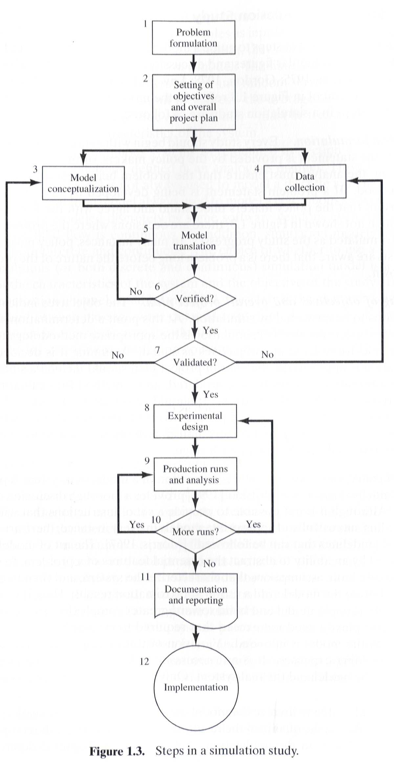

Slide 21
1.11 Steps in a Simulation Study (1)
Problem formulation
Policy maker/Analyst understand and agree with the formulation.
Setting of objectives and overall project plan
Model conceptualization
The art of modeling is enhanced by an ability to abstract the essential features of a problem, to select and modify basic assumptions that characterize the system, and then to enrich and elaborate the model until a useful approximation results.
Data collection
As the complexity of the model changes, the required data elements may also change.
Model translation
GPSS/HTM or special-purpose simulation software

Slide 22
1.11 Steps in a Simulation Study (2)
Verified?
Is the computer program performing properly?
Debugging for correct input parameters and logical structure
Validated?
The determination that a model is an accurate representation of the real system.
Validation is achieved through the calibration of the model
Experimental design
The decision on the length of the initialization period, the length of simulation runs, and the number of replications to be made of each run.
Production runs and analysis
To estimate measures of performances

Slide 23
1.11 Steps in a Simulation Study (3)
More runs?
Documentation and reporting
Program documentation : for the relationships between input parameters and output measures of performance, and for a modification
Progress documentation : the history of a simulation, a chronology of work done and decision made.
Implementation

Slide 24
1.11 Steps in a Simulation Study (4)
Four phases according to Figure 1.3
First phase : a period of discovery or orientation
(step 1, step2)
Second phase : a model building and data collection
(step 3, step 4, step 5, step 6, step 7)
Third phase : running the model
(step 8, step 9, step 10)
Fourth phase : an implementation
(step 11, step 12)

Slide 25
Ch2. Simulation Examples
Three steps of the simulations
Determine the characteristics of each of the inputs to the simulation. Quite often, these may be modeled as probability distributions, either continuous or discrete.
Construct a simulation table. Each simulation table is different, for each is developed for the problem at hand.
For each repetition i, generate a value for each of the p inputs, and evaluate the function, calculating a value of the response y_{i}. The input values may be computed by sampling values from the distributions determined in step 1. A response typically depends on the inputs and one or more previous responses.

Slide 26
The simulation table provides a systematic method for tracking system state over time.
Inputs
Response
Repetitions
X_{i1}
X_{i2}
…
X_{ij}
…
X_{ip}
y_{i}
1
2
·
·
·
n

Slide 27
2.1 Simulation of Queueing Systems (1)
Server
Waiting Line
Calling population
Fig. 2.1 Queueing System
A queueing system is described by its calling population, the nature of the arrivals, the service mechanism, the system capacity, and the queueing discipline.

Slide 28
2.1 Simulation of Queueing Systems (2)
In the single-channel queue, the calling population is infinite.
If a unit leaves the calling population and joins the waiting line or enters service, there is no change in the arrival rate of other units that may need service.
Arrivals for service occur one at a time in a random fashion.
Once they join the waiting line, they are eventually served.
Service times are of some random length according to a probability distribution which does not change over time.
The system capacity has no limit, meaning that any number of units can wait in line.
Finally, units are served in the order of their arrival (often called FIFO: First In, First out) by a single server or channel.

Slide 29
2.1 Simulation of Queueing Systems (3)
Arrivals and services are defined by the distribution of the time between arrivals and the distribution of service times, respectively.
For any simple single- or multi-channel queue, the overall effective arrival rate must be less than the total service rate, or the waiting line will grow without bound.
In some systems, the condition about arrival rate being less than service rate may not guarantee stability

Slide 30
2.1 Simulation of Queueing Systems (4)
System state : the number of units in the system and the status of the server(busy or idle).
Event : a set of circumstances that cause an instantaneous change in the state of the system.
In a single-channel queueing system there are only two possible events that can affect the state of the system.
the arrival event : the entry of a unit into the system
the departure event : the completion of service on a unit.
Simulation clock : used to track simulated time.

Slide 31
2.1 Simulation of Queueing Systems (5)
If a unit has just completed service, the simulation proceeds in the manner shown in the flow diagram of Figure 2.2.
Note that the server has only two possible states : it is either busy or idle.
Departure Event
Begin server idle time
No
Another unit waiting?
Yes
Remove the waiting unit from the queue
Begin servicing the unit
Fig. 2.2 Service-just-completed flow diagram

Slide 32
2.1 Simulation of Queueing Systems (6)
The arrival event occurs when a unit enters the system.
The unit may find the server either idle or busy.
Idle : the unit begins service immediately
Busy : the unit enters the queue for the server.
Arrival Event
Unit enters service
No
Server busy?
Yes
Unit enters queue for service
Fig. 2.3 Unit-entering-system flow diagram

Slide 33
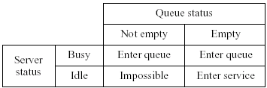
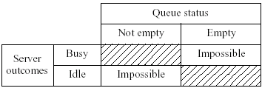
2.1 Simulation of Queueing Systems (7)
Fig. 2.4 Potential unit actions upon arrival
Fig. 2.5 Server outcomes after service completion

Slide 34
2.1 Simulation of Queueing Systems (8)
Simulations of queueing systems generally require the maintenance of an event list for determining what happens next.
Simulation clock times for arrivals and departures are computed in a simulation table customized for each problem.
In simulation, events usually occur at random times, the randomness imitating uncertainty in real life.
Random numbers are distributed uniformly and independently on the interval (0, 1).
Random digits are uniformly distributed on the set {0, 1, 2, … , 9}.
The proper number of digits is dictated by the accuracy of the data being used for input purposes.

Slide 35
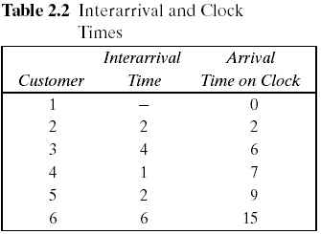
2.1 Simulation of Queueing Systems (9)
Pseudo-random numbers : the numbers are generated using a procedure → detailed in Chapter 7.
Table 2.2. Interarrival and Clock Times
Assume that the times between arrivals were generated by rolling a die five times and recording the up face.

Slide 36
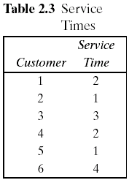
2.1 Simulation of Queueing Systems (10)
Table 2.3. Service Times
Assuming that all four values are equally likely to occur, these values could have been generated by placing the numbers one through four on chips and drawing the chips from a hat with replacement, being sure to record the numbers selected.
The only possible service times are one, two, three, and four time units.

Slide 37
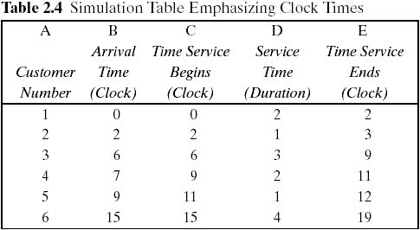
2.1 Simulation of Queueing Systems (11)
The interarrival times and service times must be meshed to simulate the single-channel queueing system.
Table 2.4 was designed specifically for a single-channel queue which serves customers on a first-in, first-out (FIFO) basis.

Slide 38
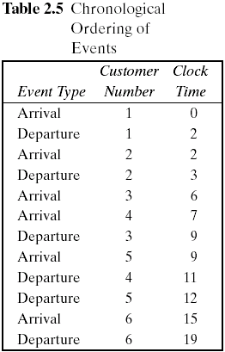
2.1 Simulation of Queueing Systems (12)
Table 2.4 keeps track of the clock time at which each event occurs.
The occurrence of the two types of events(arrival and departure event) in chronological order is shown in Table 2.5 and Figure 2.6.
Figure 2.6 is a visual image of the event listing of Table 2.5.
The chronological ordering of events is the basis of the approach to discrete-event simulation described in Chapter 3.

Slide 39
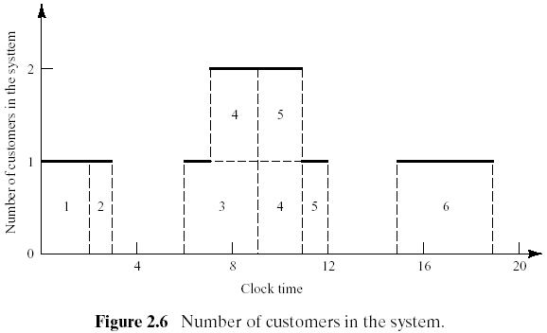
2.1 Simulation of Queueing Systems (13)
Figure 2.6 depicts the number of customers in the system at the various clock times.

Slide 40
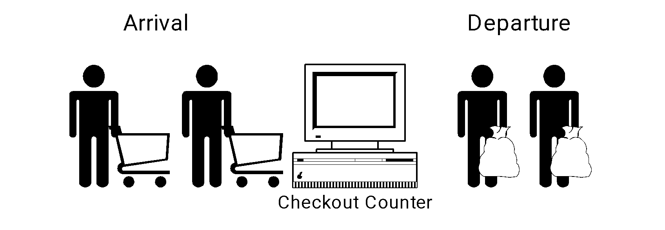
2.1 Simulation of Queueing Systems (14)
Example 2.1 Single-Channel Queue
Assumptions
Only one checkout counter.
Customers arrive at this checkout counter at random from 1 to 8 minutes apart. Each possible value of interarrival time has the same probability of occurrence, as shown in Table 2.6.
The service times vary from 1 to 6 minutes with the probabilities shown in Table 2.7.
The problem is to analyze the system by simulating the arrival and service of 20 customers.

Slide 41
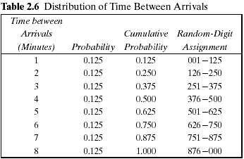
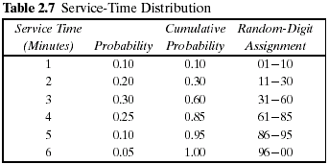
2.1 Simulation of Queueing Systems (15)

Slide 42
2.1 Simulation of Queueing Systems (16)
Example 2.1 (Cont.)
A simulation of a grocery store that starts with an empty system is not realistic unless the intention is to model the system from startup or to model until steady-state operation is reached.
A set of uniformly distributed random numbers is needed to generate the arrivals at the checkout counter. Random numbers have the following properties:
The set of random numbers is uniformly distributed between 0 and 1.
Successive random numbers are independent.
Random digits are converted to random numbers by placing a decimal point appropriately.
Table A.1 in Appendix or RAND() in Excel.
The rightmost two columns of Tables 2.6 and 2.7 are used to generate random arrivals and random service times.

Slide 43
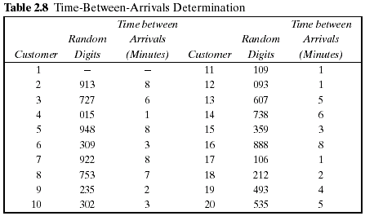
2.1 Simulation of Queueing Systems (17)
Example 2.1 (Cont.) Table 2.8
The first random digits are 913. To obtain the corresponding time between arrivals, enter the fourth column of Table 2.6 and read 8 minutes from the first column of the table.

Slide 44
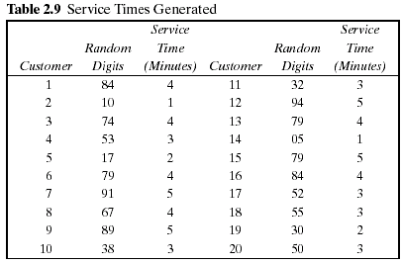
2.1 Simulation of Queueing Systems (18)
Example 2.1 (Cont.) Table 2.9
The first customer's service time is 4 minutes because the random digits 84 fall in the bracket 61-85

Slide 45
2.1 Simulation of Queueing Systems (19)
Example 2.1 (Cont.)
The essence of a manual simulation is the simulation table.
The simulation table for the single-channel queue, shown in Table 2.10, is an extension of the type of table already seen in Table 2.4.
Statistical measures of performance can be obtained form the simulation table such as Table 2.10.
Statistical measures of performance in this example.
Each customer's time in the system
The server's idle time
In order to compute summary statistics, totals are formed as shown for service times, time customers spend in the system, idle time of the server, and time the customers wait in the queue.

Slide 46
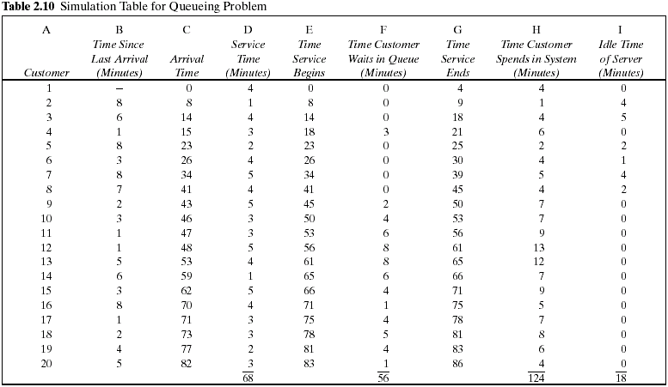

Slide 47
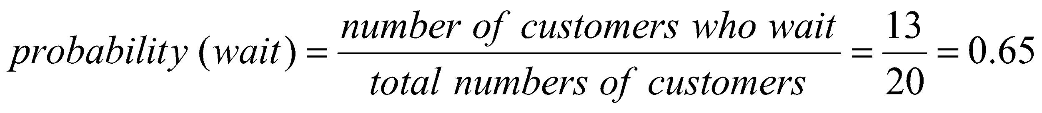
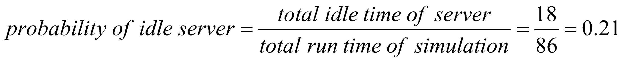
2.1 Simulation of Queueing Systems (20)
The probability of the server being busy: 0.79 (=1-0.21)
Example 2.1 (Cont.)
The average waiting time for a customer : 2.8 minutes
The probability that a customer has to wait in the queue : 0.65
The fraction of idle time of the server : 0.21

Slide 48
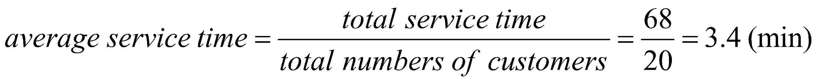
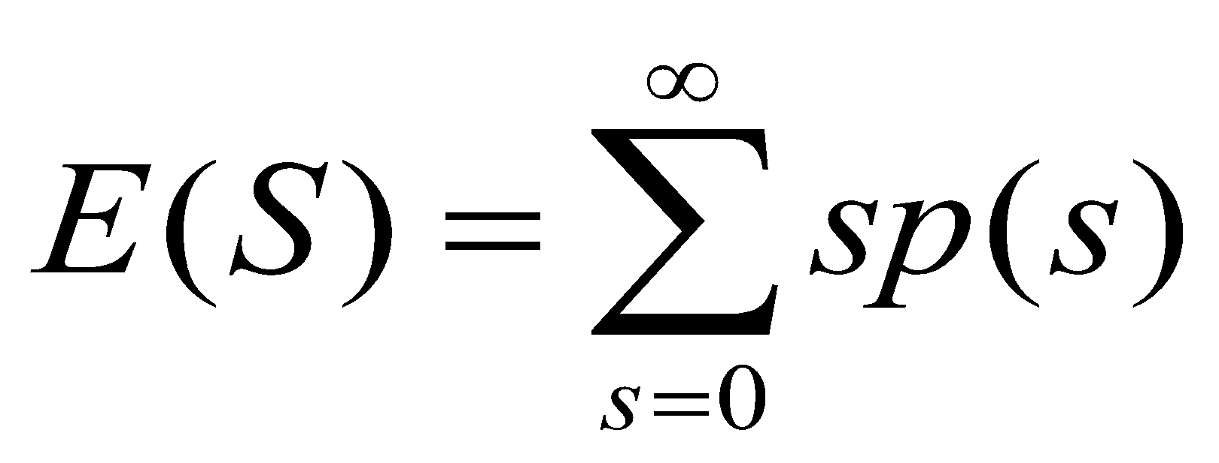
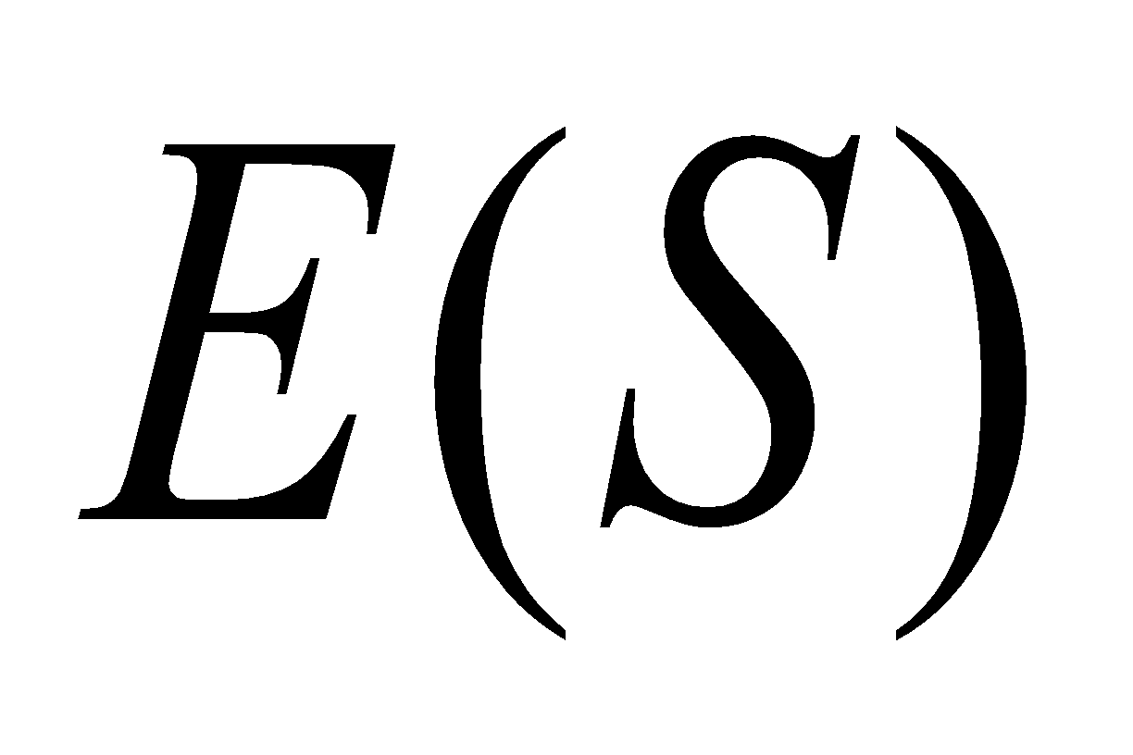
2.1 Simulation of Queueing Systems (21)
Example 2.1 (Cont.)
The average service time : 3.4 minutes
This result can be compared with the expected service time by finding the mean of the service-time distribution using the equation in table 2.7.
The expected service time is slightly lower than the average service time in the simulation. The longer the simulation, the closer the average will be to

Slide 49
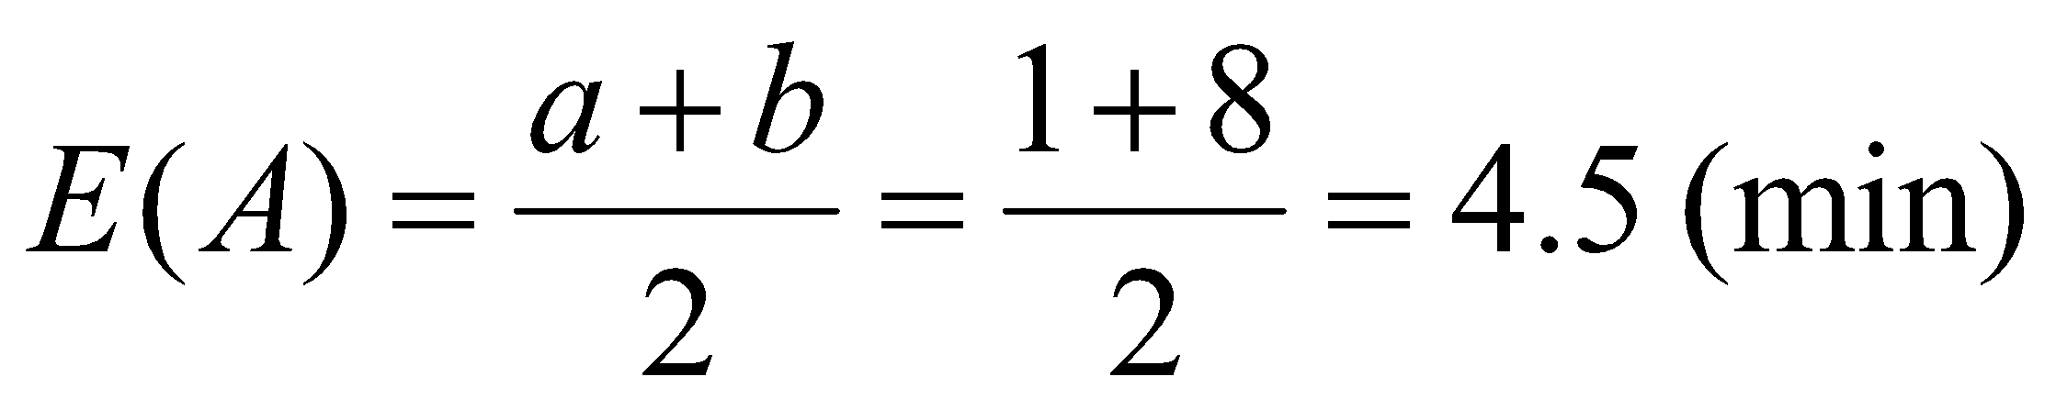
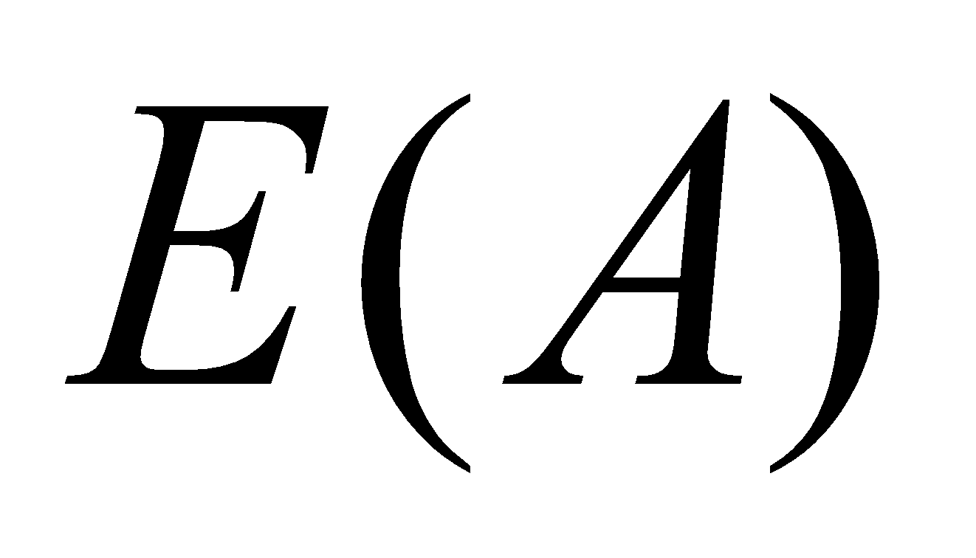
2.1 Simulation of Queueing Systems (22)
Example 2.1 (Cont.)
The average time between arrivals : 4.3 minutes
This result can be compared to the expected time between arrivals by finding the mean of the discrete uniform distribution whose endpoints are a=1 and b=8.
The longer the simulation, the closer the average will be to
The average waiting time of those who wait : 4.3 minutes

Slide 50
2.1 Simulation of Queueing Systems (23)
Example 2.1 (Cont.)
The average time a customer spends in the system : 6.2 minutes
average time
customer spends
in the system
average time
customer spends
waiting in the queue
average time
customer spends
in service
=
+
∴ average time customer spends in the system = 2.8 + 3.4 = 6.2 (min)

Slide 51
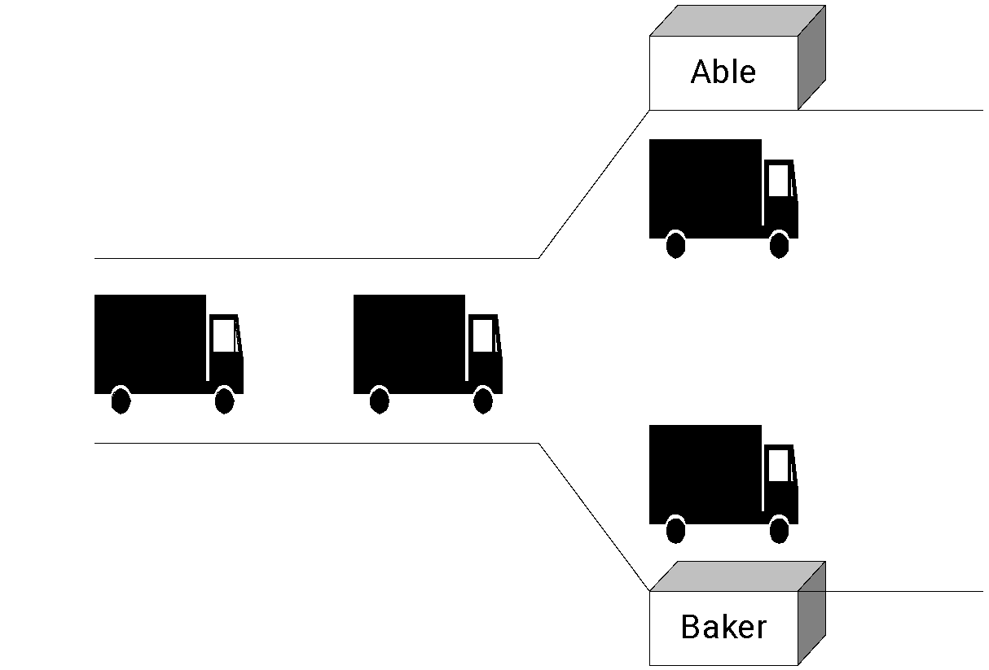
2.1 Simulation of Queueing Systems (24)
Example 2.2 The Able Baker Carhop Problem
A drive-in restaurant where carhops take orders and bring food to the car.
Assumptions
Cars arrive in the manner shown in Table 2.11.
Two carhops Able and Baker - Able is better able to do the job and works a bit faster than Baker.
The distribution of their service times is shown in Tables 2.12 and 2.13.

Slide 52
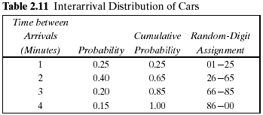
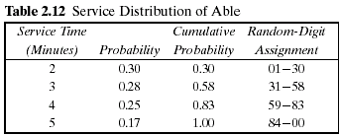
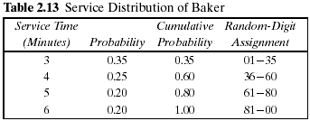
2.1 Simulation of Queueing Systems (25)
Example 2.2 (Cont.)
A simplifying rule is that Able gets the customer if both carhops are idle.
If both are busy, the customer begins service with the first server to become free.
To estimate the system measures of performance, a simulation of 1 hour of operation is made.
The problem is to find how well the current arrangement is working.

Slide 53
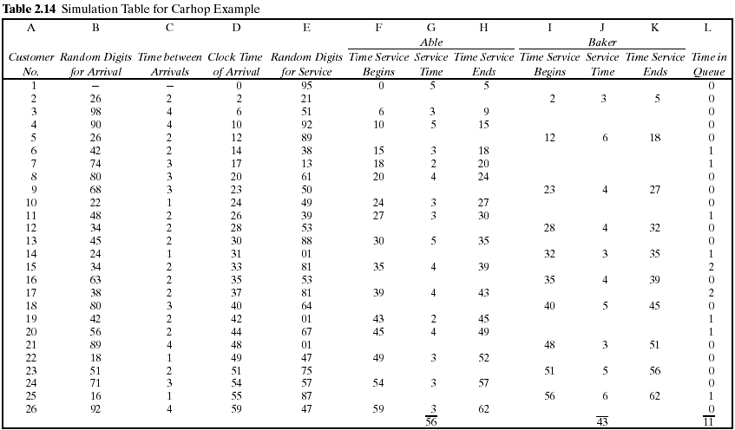

Slide 54
2.1 Simulation of Queueing Systems (26)
Example 2.2 (cont.)
The row for the first customer is filled in manually, with the random-number function RAND() in case of Excel or another random function replacing the random digits.
After the first customer, the cells for the other customers must be based on logic and formulas. For example, the “Clock Time of Arrival” (column D) in the row for the second customer is computed as follows:
D2 = D1 + C2
The logic to computer who gets a given customer can use the Excel macro function IF(), which returns one of two values depending on whether a condition is true or false.
IF( condition, value if true, value if false)

Slide 55
No
No
Yes
Nothing
Is Baker idle?
Is Able idle?
Is it time of arrival?
clock = 0
Yes
Yes
No
Yes
Baker service begin (column I)
number for service time
Generate random digit for
Able service begin (column F)
number for service time
Generate random digit for
Store clock time (column H or K)
Convert random digit to random
service (column E)
Convert random digit to random
service (column E)
Is there the service
(column J)
(column G)
completed?
No
Increment clock

Slide 56
2.1 Simulation of Queueing Systems (27)
Example 2.2 (cont.)
The logic requires that we compute when Able and Baker will become free, for which we use the built-in Excel function for maximum over a range, MAX().
If the first condition (Able idle when customer 10 arrives) is true, then the customer begins immediately at the arrival time in D10. Otherwise, a second IF() function is evaluated, which says if Baker is idle, put nothing (..) in the cell. Otherwise, the function returns the time that Able or Baker becomes idle, whichever is first [the minimum or MIN() of their respective completion times].
A similar formula applies to cell I10 for “Time Service Begins” for Baker.

Slide 57
2.1 Simulation of Queueing Systems (28)
Example 2.2 (Cont.)
For service times for Able, you could use another IF() function to make the cell blank or have a value:
G10 = IF(F10 > 0,new service time, "")
H10 = IF(F10 > 0, F10+G10, "")

Slide 58
2.1 Simulation of Queueing Systems (29)
The analysis of Table 2.14 results in the following:
Over the 62-minute period Able was busy 90% of the time.
Baker was busy only 69% of the time. The seniority rule keeps Baker less busy (and gives Able more tips).
Nine of the 26 arrivals (about 35%) had to wait. The average waiting time for all customers was only about 0.42 minute (25 seconds), which is very small.
Those nine who did have to wait only waited an average of 1.22 minutes, which is quite low.
In summary, this system seems well balanced. One server cannot handle all the diners, and three servers would probably be too many. Adding an additional server would surely reduce the waiting time to nearly zero. However, the cost of waiting would have to be quite high to justify an additional server.

Slide 59
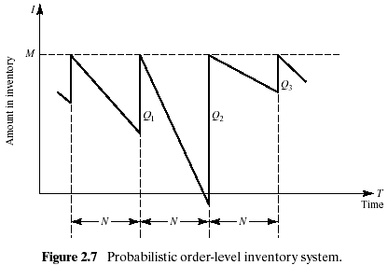
2.2 Simulation of Inventory Systems (1)
This inventory system has a periodic review of length N, at which time the inventory level is checked.
An order is made to bring the inventory up to the level M.
In this inventory system the lead time (i.e., the length of time between the placement and receipt of an order) is zero.
Demand is shown as being uniform over the time period

Slide 60
2.2 Simulation of Inventory Systems (2)
Notice that in the second cycle, the amount in inventory drops below zero, indicating a shortage.
Two way to avoid shortages
Carrying stock in inventory
: cost - the interest paid on the funds borrowed to buy the items, renting of storage space, hiring guards, and so on.
Making more frequent reviews, and consequently, more frequent purchases or replenishments
: the ordering cost
The total cost of an inventory system is the measure of performance.
The decision maker can control the maximum inventory level, M, and the length of the cycle, N.
In an (M,N) inventory system, the events that may occur are: the demand for items in the inventory, the review of the inventory position, and the receipt of an order at the end of each review period.

Slide 61
2.2 Simulation of Inventory Systems (3)
Example 2.3 The Newspaper Seller’s Problem
A classical inventory problem concerns the purchase and sale of newspapers.
The paper seller buys the papers for 33 cents each and sells them for 50 cents each. (The lost profit from excess demand is 17 cents for each paper demanded that could not be provided.)
Newspapers not sold at the end of the day are sold as scrap for 5 cents each. (the salvage value of scrap papers)
Newspapers can be purchased in bundles of 10. Thus, the paper seller can buy 50, 60, and so on.
There are three types of newsdays, “good,” “fair,” and “poor,” with probabilities of 0.35, 0.45, and 0.20, respectively.

Slide 62
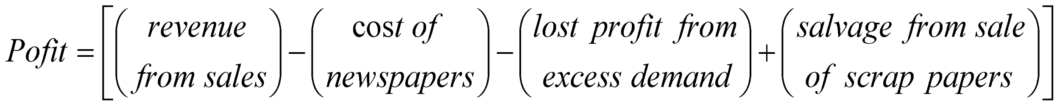
2.2 Simulation of Inventory Systems (4)
Example 2.3 (Cont.)
The problem is to determine the optimal number of papers the newspaper seller should purchase.
This will be accomplished by simulating demands for 20 days and recording profits from sales each day.
The profits are given by the following relationship:
The distribution of papers demanded on each of these days is given in Table 2.15.
Tables 2.16 and 2.17 provide the random-digit assignments for the types of newsdays and the demands for those newsdays.

Slide 63
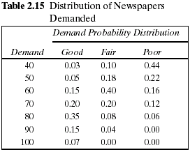
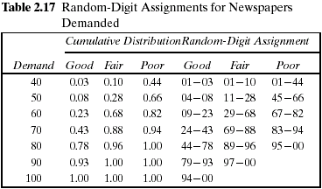
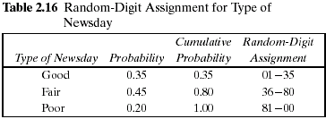
2.2 Simulation of Inventory Systems (5)

Slide 64
2.2 Simulation of Inventory Systems (6)
Example 2.3 (Cont.)
The simulation table for the decision to purchase 70 newspapers is shown in Table 2.18.
The profit for the first day is determined as follows:
Profit = $30.00 - $23.10 - 0 + $.50 = $7.40
On day 1 the demand is for 60 newspapers. The revenue from the sale of 60 newspapers is $30.00.
Ten newspapers are left over at the end of the day.
The salvage value at 5 cents each is 50 cents.
The profit for the 20-day period is the sum of the daily profits, $174.90. It can also be computed from the totals for the 20 days of the simulation as follows:
Total profit = $645.00 - $462.00 - $13.60 + $5.50 = $174.90
The policy (number of newspapers purchased) is changed to other values and the simulation repeated until the best value is found.

Slide 65
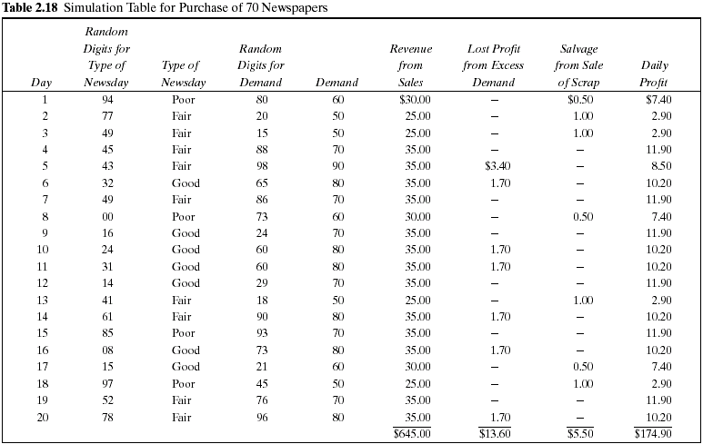

Slide 66
2.2 Simulation of Inventory Systems (7)
Example 2.4 Simulation of an (M,N) Inventory System
This example follows the pattern of the probabilistic order-level inventory system shown in Figure 2.7.
Suppose that the maximum inventory level, M, is11 units and the review period, N, is 5 days. The problem is to estimate, by simulation, the average ending units in inventory and the number of days when a shortage condition occurs.
The distribution of the number of units demanded per day is shown in Table 2.19.
In this example, lead time is a random variable, as shown in Table 2.20.
Assume that orders are placed at the close of business and are received for inventory at the beginning of business as determined by the lead time.

Slide 67
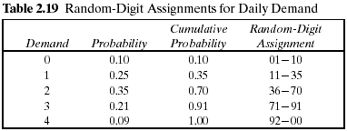
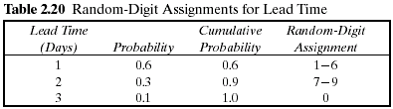
2.2 Simulation of Inventory Systems (8)
Example 2.4 (Cont.)
For purposes of this example, only five cycles will be shown.
The random-digit assignments for daily demand and lead time are shown in the rightmost columns of Tables 2.19 and 2.20.

Slide 68
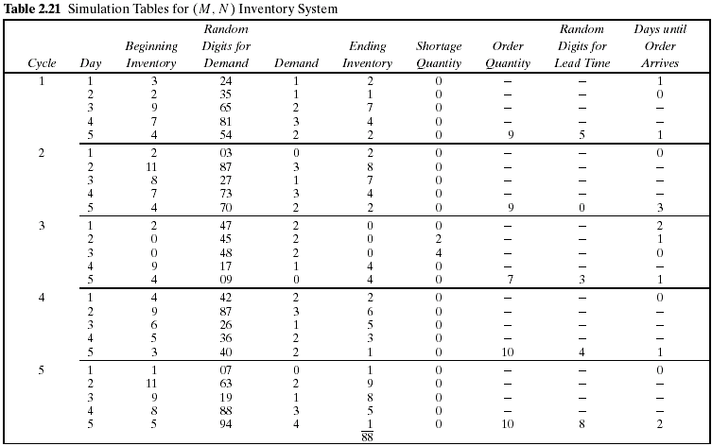

Slide 69
2.2 Simulation of Inventory Systems (9)
Example 2.4 (Cont.)
The simulation has been started with the inventory level at 3 units and an order of 8 units scheduled to arrive in 2 days' time.
Beginning Inventory of Third day
Ending Inventory of 2 day in first cycle
=
+
new order
The lead time for this order was 1 day.
Notice that the beginning inventory on the second day of the third cycle was zero. An order for 2 units on that day led to a shortage condition. The units were backordered on that day and the next day also. On the morning of day 4 of cycle 3 there was a beginning inventory of 9 units. The 4 units that were backordered and the 1 unit demanded that day reduced the ending inventory to 4 units.
Based on five cycles of simulation, the average ending inventory is approximately 3.5 (88 ÷ 25) units. On 2 of 25 days a shortage condition existed.

Slide 70
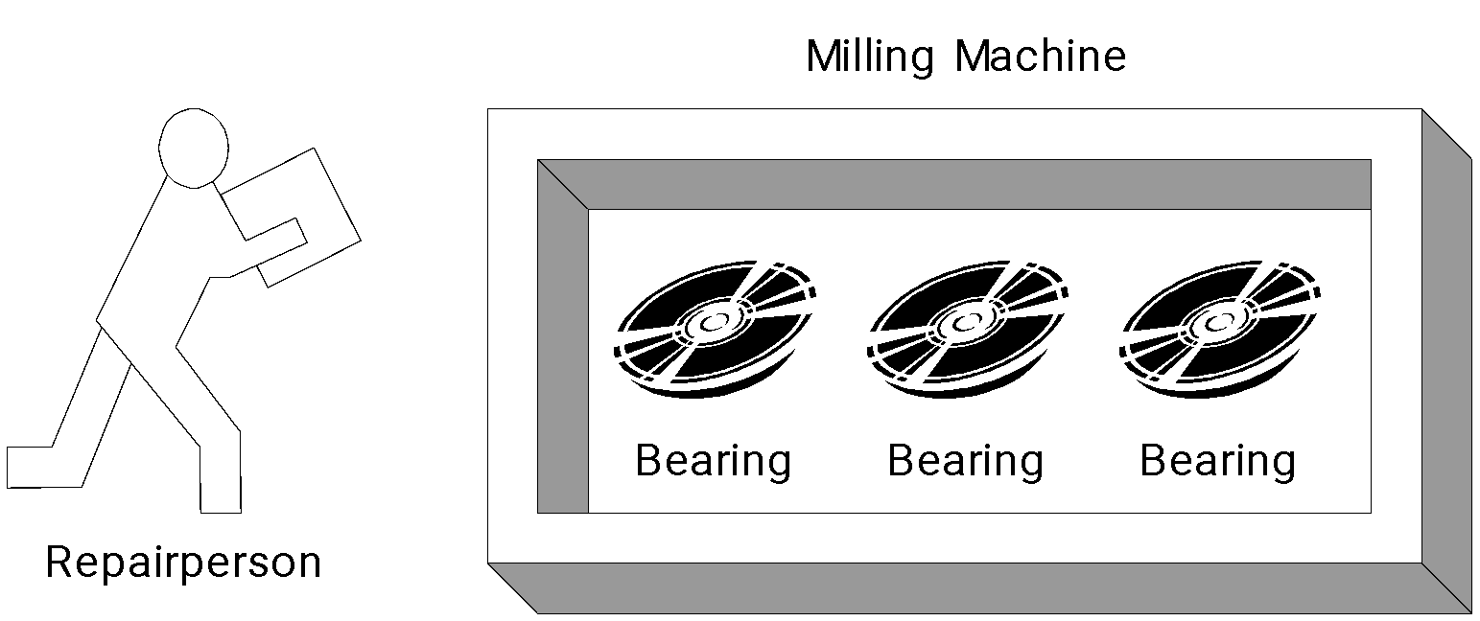
2.3 Other Examples of Simulation (1)
Example 2.5 A Reliability Problem
Downtime for the mill is estimated at $5 per minute.
The direct on-site cost of the repairperson is $15 per hour.
It takes 20 minutes to change one bearing, 30 minutes to change two bearings, and 40 minutes to change three bearings.
The bearings cost $16 each.
A proposal has been made to replace all three bearings whenever a bearing fails.

Slide 71
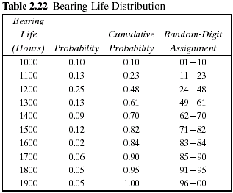
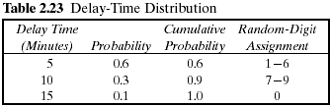
2.3 Other Examples of Simulation (2)
Example 2.5 (Cont.)
The delay time of the repairperson's arriving at the milling machine is also a random variable, with the distribution given in Table 2.23.
The cumulative distribution function of the life of each bearing is identical, as shown in Table 2.22.

Slide 72
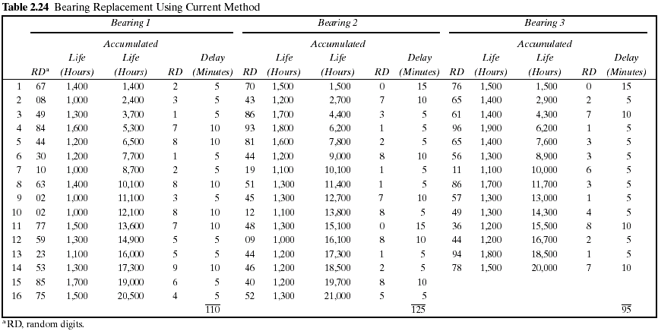

Slide 73
2.3 Other Examples of Simulation (3)
Example 2.5 (Cont.)
Table 2.24 represents a simulation of 20,000 hours of operation under the current method of operation.
Note that there are instances where more than one bearing fails at the same time.
This is unlikely to occur in practice and is due to using a rather coarse grid of 100 hours.
It will be assumed in this example that the times are never exactly the same, and thus no more than one bearing is changed at any breakdown. Sixteen bearing changes were made for bearings 1 and 2, but only 14 bearing changes were required for bearing 3.

Slide 74
2.3 Other Examples of Simulation (4)
Example 2.5 (Cont.)
The cost of the current system is estimated as follows:
Cost of bearings = 46 bearings × $16/bearing = $736
Cost of delay time = (110 + 125 + 95) minutes × $5/minute = $1650
Cost of downtime during repair =
46 bearings × 20 minutes/bearing × $5/minute = $4600
Cost of repairpersons =
46 bearings × 20 minutes/bearing × $15/60 minutes = $230
Total cost = $736 + $1650 + $4600 + $230 = $7216
Table 2.25 is a simulation using the proposed method. Notice that bearing life is taken from Table 2.24, so that for as many bearings as were used in the current method, the bearing life is identical for both methods.

Slide 75
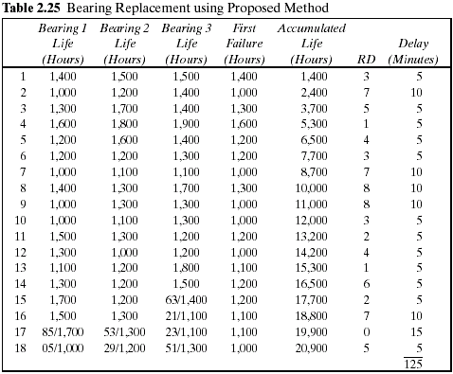

Slide 76
2.3 Other Examples of Simulation (5)
Example 2.5 (Cont.)
Since the proposed method uses more bearings than the current method, the second simulation uses new random digits for generating the additional lifetimes.
The random digits that lead to the lives of the additional bearings are shown above the slashed line beginning with the 15th replacement of bearing 3.
The total cost of the new policy :
Cost of bearings = 54 bearings × $16/bearing = $864
Cost of delay time = 125 minutes × $5/minute = $625
Cost of downtime during repairs = 18 sets × 40 minutes/set × $5/minute = $3600
Cost of repairpersons = 18 sets × 40 minutes/set × $15/60 minutes = $180
Total cost = $864 + $625 + $3600 + $180 = $5269
The new policy generates a savings of $1947 over a 20,000-hour simulation. If the machine runs continuously, the simulated time is about 2 1/4 years. Thus, the savings are about $865 per year.

Slide 77
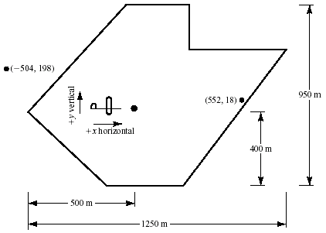
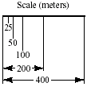
2.3 Other Examples of Simulation (6)
Example 2.6 Random Normal Numbers
A classic simulation problem is that of a squadron of bombers attempting to destroy an ammunition depot shaped as shown in Figure 2.8.

Slide 78
2.3 Other Examples of Simulation (7)
Example 2.6 (Cont.)
If a bomb lands anywhere on the depot, a hit is scored. Otherwise, the bomb is a miss.
The aircraft fly in the horizontal direction.
Ten bombers are in each squadron.
The aiming point is the dot located in the heart of the ammunition dump.
The point of impact is assumed to be normally distributed around the aiming point with a standard deviation of 600 meters in the horizontal direction and 300 meters in the vertical direction.
The problem is to simulate the operation and make statements about the number of bombs on target.

Slide 79
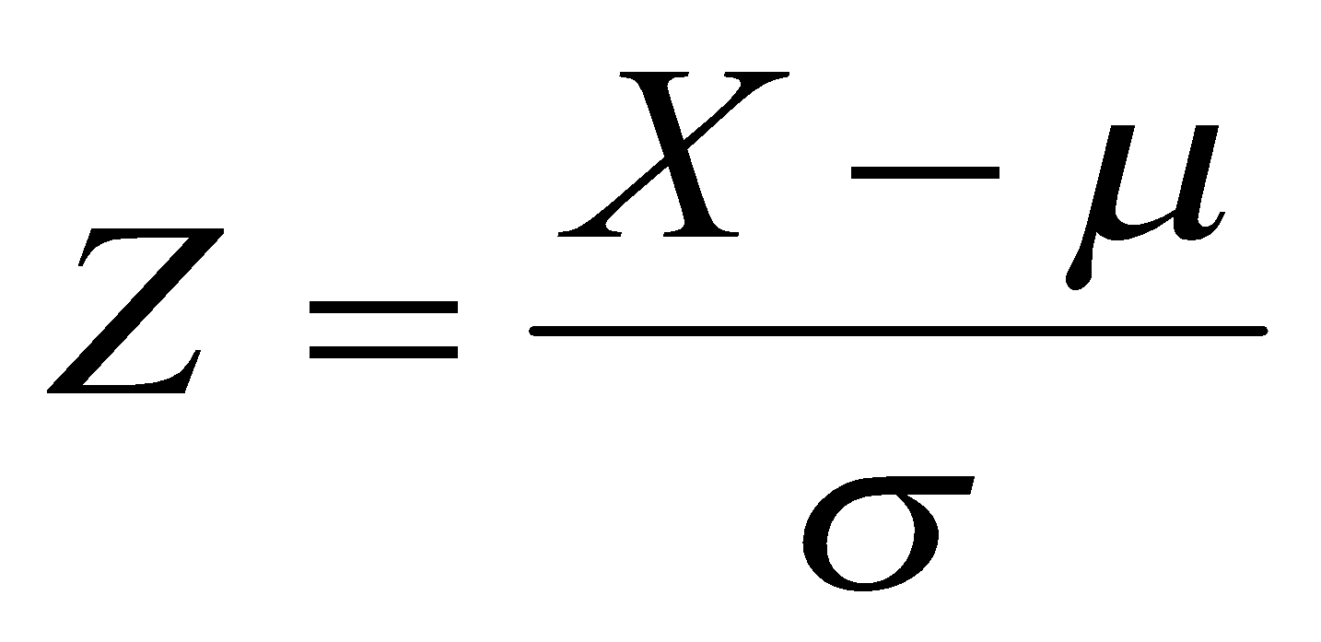
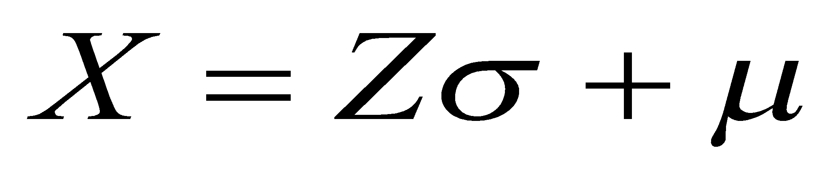


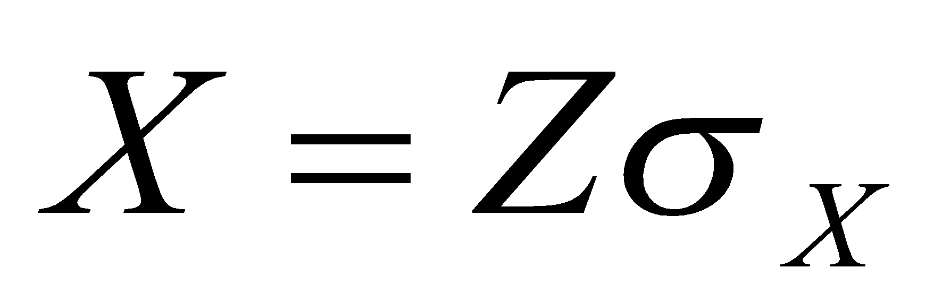
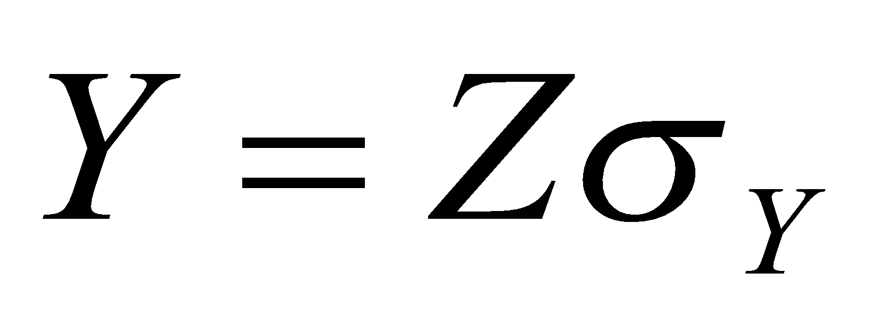




2.3 Other Examples of Simulation (8)
Example 2.6 (Cont.)
The standardized normal variate, Z, with mean 0 and standard deviation 1, is distributed as
where X is a normal random variable, is the true mean of the distribution of X, and is the standard deviation of X.
In this example the aiming point can be considered as (0, 0); that is, the value in the horizontal direction is 0, and similarly for the value in the vertical direction.
where (X,Y) are the simulated coordinates of the bomb after it has fallen
and

Slide 80
2.3 Other Examples of Simulation (9)
Example 2.6 (Cont.)
The values of Z are random normal numbers.
These can be generated from uniformly distributed random numbers, as discussed in Chapter 7.
Alternatively, tables of random normal numbers have been generated. A small sample of random normal numbers is given in Table A.2.
For Excel, use the Random Number Generation tool in the Analysis TookPak Add-In to generate any number of normal random values in a range of cells.
The table of random normal numbers is used in the same way as the table of random numbers.
Table 2.26 shows the results of a simulated run.

Slide 81

2.3 Other Examples of Simulation (10)
Example 2.6 (Cont.)

Slide 82


2.3 Other Examples of Simulation (11)
Example 2.6 (Cont.)
The mnemonic stands for .random normal number to compute the x coordinate. and corresponds to above.
The first random normal number used was –0.84, generating an x coordinate 600(-0.84) = -504.
The random normal number to generate the y coordinate was 0.66, resulting in a y coordinate of 198.
Taken together, (-504, 198) is a miss, for it is off the target.
The resulting point and that of the third bomber are plotted on Figure 2.8.
The 10 bombers had 3 hits and 7 misses.
Many more runs are needed to assess the potential for destroying the dump.
This is an example of a Monte Carlo, or static, simulation, since time is not an element of the solution.

Slide 83

2.3 Other Examples of Simulation (12)
Example 2.7 Lead-Time Demand
Lead-time demand may occur in an inventory system.
The lead time is the time from placement of an order until the order is received.
In a realistic situation, lead time is a random variable.
During the lead time, demands also occur at random. Lead-time demand is thus a random variable defined as the sum of the demands over the lead time, or
where i is the time period of the lead time, i = 0, 1, 2, … , D_{i} is the demand during the i^{th} time period; and T is the lead time.
The distribution of lead-time demand is determined by simulating many cycles of lead time and building a histogram based on the results.

Slide 84




2.3 Other Examples of Simulation (13)
Example 2.7 (Cont.)
The daily demand is given by the following probability distribution:
The lead time is a random variable given by the following distribution:

Slide 85

2.3 Other Examples of Simulation (14)
Example 2.7 (Cont.)
The incomplete simulation table is shown in Table 2.29.
The random digits for the first cycle were 57. This generates a lead time of 2 days.
Thus, two pairs of random digits must be generated for the daily demand.

Slide 86

2.3 Other Examples of Simulation (15)
Example 2.7 (Cont.)
The histogram might appear as shown in Figure 2.9.
This example illustrates how simulation can be used to study an unknown distribution by generating a random sample from the distribution.

Slide 87
2.4 Summary
This chapter introduced simulation concepts via examples in order to illustrate general areas of application and to motivate the remaining chapters.
The next chapter gives a more systematic presentation of the basic concepts. A more systematic methodology, such as the event-scheduling approach described in Chapter 3, is needed.
Ad hoc simulation tables were used in completing each example. Events in the tables were generated using uniformly distributed random numbers and, in one case, random normal numbers.
The examples illustrate the need for determining the characteristics of the input data, generating random variables from the input models, and analyzing the resulting response.

Slide 88
Ch. 3 General Principles
Discrete-event simulation
The basic building blocks of all discrete-event simulation models
: entities and attributes, activities and events.
A system is modeled in terms of
its state at each point in time
the entities that pass through the system and the entities that represent system resources
the activities and events that cause system state to change.
Discrete-event models are appropriate for those systems for which changes in system state occur only at discrete points in time.
This chapter deals exclusively with dynamic, stochastic systems (i.e., involving time and containing random elements) which change in a discrete manner.

Slide 89
3.1Concepts in Discrete-Event Simulation (1)
System : A collection of entities (e.g., people and machines) that interact
together over time to accomplish one or more goals.
Model : An abstract representation of a system, usually containing
structural, logical, or mathematical relationships which describe a
system in terms of state, entities and their attributes, sets, processes,
events, activities, and delays.
System state : A collection of variables that contain all the information
necessary to describe the system at any time.
Entity : Any object or component in the system which requires explicit
representation in the model (e.g., a server, a customer, a machine).
Attributes : The properties of a given entity (e.g., the priority of a waiting
customer, the routing of a job through a job shop).

Slide 90
3.1Concepts in Discrete-Event Simulation (2)
List : A collection of (permanently or temporarily) associated entities, ordered
in some logical fashion (such as all customers currently in a waiting line,
ordered by first come, first served, or by priority).
Event : An instantaneous occurrence that changes the state of a system
(such as an arrival of a new customer).
Event notice : A record of an event to occur at the current or some future
time, along with any associated data necessary to execute the
event; at a minimum, the record includes the event type and
the event time.
Event list : A list of event notices for future events, ordered by time of
occurrence also known as the future event list (FEL).
Activity : A duration of time of specified length (e.g., a service time or
interarrival time), which is known when it begins (although it may be
defined in terms of a statistical distribution).

Slide 91
3.1Concepts in Discrete-Event Simulation (3)
Delay : A duration of time of unspecified indefinite length, which is not
known until it ends (e.g., a customer's delay in a last-in, first-out
waiting line which, when it begins, depends on future arrivals).
Clock : A variable representing simulated time, called CLOCK in the
examples to follow.
An activity typically represents a service time, an interarrival time, or any other processing time whose duration has been characterized and defined by the modeler.
An activity's duration may be specified in a number of ways:
1. Deterministic-for example, always exactly 5 minutes;
2. Statistical-for example, as a random draw from among 2, 5, 7 with equal
probabilities;
3. A function depending on system variables and/or entity attributes-for example,
loading time for an iron ore ship as a function of the ship's allowed cargo
weight and the loading rate in tons per hour.

Slide 92
3.1Concepts in Discrete-Event Simulation (4)
an end of inspection event
event time = 105
Event notice
100
105
time
current simulated time
Inspection time (=5)
The duration of an activity is computable from its specification at the instant it begins.
To keep track of activities and their expected completion time, at the simulated instant that an activity duration begins, an event notice is created having an event time equal to the activity's completion time.

Slide 93

3.1Concepts in Discrete-Event Simulation (5)
A delay's duration
Not specified by the modeler ahead of time, But rather determined by system conditions.
Quite often, a delay's duration is measured and is one of the desired outputs of a model run.
A customer's delay in a waiting line may be dependent on the number and duration of service of other customers ahead in line as well as the availability of servers and equipment.

Slide 94
3.1Concepts in Discrete-Event Simulation (6)
 | Delay | Activity
What so called | a conditional wait | an unconditional wait
A completion | a secondary event | a primary event
A management | by placing an event notice on the FEL | by placing the associated entity on another list, not the FEL, perhaps repre-senting a waiting line
System state, entity attributes and the number of active entities, the
contents of sets, and the activities and delays currently in progress are all
functions of time and are constantly changing over time.
Time itself is represented by a variable called CLOCK.

Slide 95



3.1Concepts in Discrete-Event Simulation (7)
EXAMPLE 3.1 (Able and Baker, Revisited)
Consider the Able-Baker carhop system of Example 2.2.
System state
: the number of cars waiting to be served at time t
: 0 or 1 to indicate Able being idle or busy at time t
: 0 or 1 to indicate Baker being idle or busy at time t
Entities : Neither the customers (i.e., cars) nor the servers need
to be explicitly represented, except in terms of the
state variables, unless certain customer averages are
desired (compare Examples 3.4 and 3.5)
Events
Arrival event
Service completion by Able
Service completion by Baker

Slide 96
3.1Concepts in Discrete-Event Simulation (8)
EXAMPLE 3.1 (Cont.)
Activities
Interarrival time, defined in Table 2.11
Service time by Able, defined in Table 2.12
Service time by Baker, defined in Table 2.13
Delay : A customer's wait in queue until Able or Baker becomes free
The definition of the model components provides a static description of the model.
A description of the dynamic relationships and interactions between the components is also needed.

Slide 97

3.1Concepts in Discrete-Event Simulation (9)
A discrete-event simulation
: the modeling over time of a system all of whose state changes occur
at discrete points in time-those points when an event occurs.
A discrete-event simulation proceeds by producing a sequence of system snapshots (or system images) which represent the evolution of the system through time.
Figure 3.1 Prototype system snapshot at simulation time t

Slide 98

3.1.1. The Event-Scheduling/Time-Advanced Algorithm (1)
The mechanism for advancing simulation time and guaranteeing that all events occur in correct chronological order is based on the future event list (FEL).
Future Event List (FEL)
to contain all event notices for events that have been scheduled to occur at a future time.
to be ordered by event time, meaning that the events are arranged chronologically; that is, the event times satisfy
Scheduling a future event means that at the instant an activity begins, its duration is computed or drawn as a sample from a statistical distribution and the end-activity event, together with its event time, is placed on the future event list.
current value of simulated time
Imminent event

Slide 99


Slide 100
3.1.1. The Event-Scheduling/Time-Advanced Algorithm (2)
List processing : the management of a list .
the removal of the imminent event
: As the imminent event is usually at the top of the list, its removal is as
efficient as possible.
the addition of a new event to the list, and occasionally removal of some event (called cancellation of an event)
: Addition of a new event (and cancellation of an old event) requires a
search of the list.
The efficiency of this search depends on the logical organization of the list and on how the search is conducted.
The removal and addition of events from the FEL is illustrated in Figure 3.2.

Slide 101
3.1.1. The Event-Scheduling/Time-Advanced Algorithm (3)
The system snapshot at time 0 is defined by the initial conditions and the generation of the so-called exogenous events.
An exogenous event : a happening “outside the system” which
impinges on the system.
The specified initial conditions define the system state at time 0.
In Figure 3.2, if t = 0, then the state (5, 1, 6) might represent the initial number of customers at three different points in the system.
How future events are generated?
to generate an arrival to a queueing system
by a service-completion event in a queueing simulation
to generate runtimes and downtimes for a machine subject to breakdowns

Slide 102

3.1.1. The Event-Scheduling/Time-Advanced Algorithm (4)
To generate an arrival to a queueing system
- The end of an interarrival interval is an example of a primary event.

Slide 103
3.1.1. The Event-Scheduling/Time-Advanced Algorithm (5)
By a service-completion event in a queueing simulation
A new service time, s*, will be generated for the next customer.
When one customer completes service, at current time CLOCK = t
If the next customer is present
⇒ The next service-completion event will be scheduled to occur at future
time t* = t + s* by placing onto the FEL a new event notice of type service
completion.
A service-completion event will be generated and scheduled at the
time of an arrival event, provided that, upon arrival, there is at least one
idle server in the server group.
Beginning service : a conditional event triggered only on the condition
that a customer is present and a server is free.
Service completion : a primary event.
Service time : an activity

Slide 104
3.1.1. The Event-Scheduling/Time-Advanced Algorithm (6)
By a service-completion event in a queueing simulation (Cont.)
A conditional event is triggered by a primary event occurring
Only primary events appear on the FEL.
To generate runtimes and downtimes for a machine subject to
breakdowns
At time 0, the first runtime will be generated and an end-of-runtime
event scheduled.
Whenever an end-of-runtime event occurs, a downtime will be
generated and an end-of-downtime event scheduled on the FEL.
When the CLOCK is eventually advanced to the time of this end-of-
downtime event, a runtime is generated and an end-of-runtime event
scheduled on the FEL.
An end of runtime and an end of downtime : primary events.
A runtime and a downtime : activities

Slide 105
3.1.1. The Event-Scheduling/Time-Advanced Algorithm (7)
Every simulation must have a stopping event, here called E, which defines
how long the simulation will run.
There are generally two ways to stop a simulation:
1. At time 0, schedule a stop simulation event at a specified future time T_{E}.
Ex) Simulate a job shop for T_{E} = 40 hours,that is,over the time interval [0, 40].
2. Run length T_{E} is determined by the simulation itself. Generally, T_{E} is the time of
occurrence of some specified event E.
Ex) the time of the 100th service completion at a certain service center.
the time of breakdown of a complex system.
the time of disengagement or total kill in a combat simulation.
the time at which a distribution center ships the last carton in a day's orders.
In case 2, T_{E} is not known ahead of time. Indeed, it may be one of the
statistics of primary interest to be produced by the simulation.

Slide 106
3.1.2. World Views (1)
World views
: the event-scheduling world view, the process-interaction world view, and the
activity-scanning world view.
The process-interaction approach
To focus on entities and their life cycle
Process : the life cycle of one entity
: a time-sequenced list of events, activities, and delays, including
demands for resources, that define the life cycle of one entity
as it moves through a system.
The life cycle consists of various events and activities.
Some activities may require the use of one or more resources whose
capacities are limited (queueing).

Slide 107

3.1.2. World Views (2)
The process-interaction approach (Cont.)
Figure 3.4 shows the interaction between two customer processes as customer n+1 is delayed until the previous customer's “end-service event” occurs.

Slide 108
3.1.2. World Views (3)
The activity-scanning approach
Simple in concept, but slow runtime on computers
: Both the event-scheduling and the process-interaction approaches
use a variable time advance.
: The activity-scanning approach uses a fixed time increment and
a rule-based approach to decide whether any activities can begin
at each point in simulated time.
To focus on the activities and those conditions
At each clock advance, the conditions for each activity are checked and,
if the conditions are true, then the corresponding activity begins.
Three-phase approach
: to combine pure activity-scanning approach with the features of event
scheduling, variable time advance.
: events are considered to be activities of duration-zero time units.

Slide 109
3.1.2. World Views (4)
The activity-scanning approach (Cont.)
In the three-phase approach, activities are divided into two categories.
- B activities : activities bound to occur; all primary events and
unconditional activities.
- C activities : activities or events that are conditional upon certain
conditions being true.
Phase A : Remove the imminent event from the FEL and advance the clock
to its event time. Remove any other events from the FEL that
have the same event time.
Phase B : Execute all B-type events that were removed from the FEL.
Phase C : Scan the conditions that trigger each C-type activity and
activate any whose conditions are met. Rescan until no
additional C-type activities can begin or events occur.

Slide 110
3.1.2. World Views (5)
EXAMPLE 3.2 (Able and Baker, Back Again)
The events and activities were identified in Example 3.1.
Using the three-phase approach, the conditions for beginning each activity in Phase C are:
Using the process-interaction approach, we view the model from the viewpoint of a customer and its “life cycle.” Considering a life cycle beginning upon arrival, a customer process is pictured in Figure 3.4
Activity | Condition
Service time by Able | A customer is in queue and Able is idle
Service time by Baker | A customer is in queue, Baker is idle, and Able is busy

Slide 111
3.1.3. Manual Simulation Using Event Scheduling (1)
Example 3.3 (Single-Channel Queue)
Reconsider Example 2.1
System state (LQ(t), LS(t)) :
LQ(t) is the number of customers in the waiting line
LS(t) is the number being served (0 or 1) at time t
Entities : The server and customers are not explicitly modeled,
except in terms of the state variables above.
Events :
Arrival (A)
Departure (D)
Stopping event (E), scheduled to occur at time 60.

Slide 112
3.1.3. Manual Simulation Using Event Scheduling (2)
Example 3.3 (Cont.)
Event notices (event type, event time) :
(A, t ), representing an arrival event to occur at future time t
(D, t ), representing a customer departure at future time t
(E, 60), representing the simulation-stop event at future time 60.
Activities :
Interarrival time, defined in Table 2.6
Service time, defined in Table 2.7
Delay : Customer time spent in waiting line.
The effect of the arrival and departure events was first shown in Figures 2.2 and 2.3 and is shown in more detail in Figures 3.5 and 3.6.

Slide 113


Slide 114


Slide 115

3.1.3. Manual Simulation Using Event Scheduling (3)
Example 3.3 (Cont.)
The interarrival times and service times will be identical to those used in Table 2.10
Initial conditions
the system snapshot at time zero (CLOCK = 0)
LQ(0) = 0, LS(0) = 1
both a departure event and arrival event on the FEL.
The simulation is scheduled to stop at time 60.
Server utilization : total server busy time (B) / total time (T_{E}).
a* : the generated interarrival time
s* : the generated service times
The simulation in Table 3.1 covers the time interval [0, 21].

Slide 116

3.1.3. Manual Simulation Using Event Scheduling (4)

Slide 117
3.1.3. Manual Simulation Using Event Scheduling (5)
Example 3.4 (The Checkout-Counter Simulation, Continued)
In Example 3.3, to estimate :
mean response time : the average length of time a customer spends
in the system
mean proportion of customers who spend 4 or more minutes in the system.
Entities (Ci, t ) : representing customer Ci who arrived at time t
Event notices :
(A, t, Ci), the arrival of customer Ci at future time t
(D, t, Cj), the departure of customer Cj at future time t
Set : “CHECKOUTLINE,” the set of all customers currently
at the checkout counter (being served or waiting to be
served), ordered by time of arrival
A customer entity with arrival time as an attribute is added in order to estimate mean response time.

Slide 118
3.1.3. Manual Simulation Using Event Scheduling (6)
Example 3.4 (Cont.)
Three new cumulative statistics will be collected :
S : the sum of customer response times for all customers who have
departed by the current time
F : the total number of customers who spend 4 or more minutes at
the checkout counter
N_{D} : the total number of departures up to the current simulation time.
These three cumulative statistics will be updated whenever the
departure event occurs.
The simulation table for Example 3.4 is shown in Table 3.2.
The response time for customer is computed by
Response time = CLOCK TIME - attribute “time of arrival”

Slide 119

3.1.3. Manual Simulation Using Event Scheduling (7)
Example 3.4 (Cont.)
For a simulation run length of 21 minutes
the average response time was S/N_{D} = 15/4 = 3.75 minutes
the observed proportion of customers who spent 4 or more minutes in the system was F/N_{D} = 0.75.

Slide 120




3.1.3. Manual Simulation Using Event Scheduling (8)
Example 3.5 (The Dump Truck Problem, Figure 3.7)
Traveling
Loading
Scale
Loader
Weighing
queue
queue
First-Come First-Served
First-Come First-Served
The distributions of loading time, weighing time, and travel time are given in Tables 3.3, 3.4, and 3.5, respectively, from Table A.1.
The purpose of the simulation is to estimate the loader and scale utilizations (percentage of time busy).

Slide 121




3.1.3. Manual Simulation Using Event Scheduling (9)
The activity times are taken from the following list as needed:

Slide 122
3.1.3. Manual Simulation Using Event Scheduling (10)
Example 3.5 (Cont.)
System state [LQ(t), L(t), WQ(t), W(t)]
LQ(t) = number of trucks in loader queue
L(t) = number of trucks (0, 1, or 2) being loaded
WQ(t) = number of trucks in weigh queue
W(t) = number of trucks (0 or 1) being weighed, all at simulation
time t
Event notices :
(ALQ, t, DTi ), dump truck i arrives at loader queue (ALQ) at time t
(EL, t, DTi), dump truck i ends loading (EL) at time t
(EW, t, DTi), dump truck i ends weighing (EW) at time t
Entities : The six dump trucks (DT 1, … , DT 6)

Slide 123
3.1.3. Manual Simulation Using Event Scheduling (11)
Example 3.5 (Cont.)
Lists :
Loader queue : all trucks waiting to begin loading, ordered on
a first come, first served basis
Weigh queue : all trucks waiting to be weighed, ordered on a first
come, first served basis
Activities : Loading time, weighing time, and travel time
Delays : Delay at loader queue, and delay at scale
It has been assumed that five of the trucks are at the loaders and one is at the scale at time 0.
The simulation table is given in Table 3.6.

Slide 124


Slide 125


Slide 126
3.1.3. Manual Simulation Using Event Scheduling (12)
Example 3.5 (Cont.)
This logic for the occurrence of the end-loading event
When an end-loading (EL) event occurs, say for truck j at time t , other events may be triggered.
If the scale is idle [W(t)=0], truck j begins weighing and an end-weighing event (EW) is scheduled on the FEL.
Otherwise, truck j joins the weigh queue.
If at this time there is another truck waiting for a loader, it will be removed from the loader queue and will begin loading by the scheduling of an end-loading event (EL) on the FEL.
In order to estimate the loader and scale utilizations, two cumulative statistics are maintained:
B_{L} = total busy time of both loaders from time 0 to time t
B_{S} = total busy time of the scale from time 0 to time t

Slide 127


3.1.3. Manual Simulation Using Event Scheduling (13)
Example 3.5 (Cont.)
The utilizations are estimated as follows:
average loader utilization
average scale utilization
These estimates cannot be regarded as accurate estimates of the long-run “steady-state” utilizations of the loader and scale.
A considerably longer simulation would be needed to reduce the effect of the assumed conditions at time 0 (five of the six trucks at the loaders) and to realize accurate estimates.

Slide 128

3.1.3. Manual Simulation Using Event Scheduling (14)
Example 3.6 (The Dump Truck Problem Revisited)
The events and activities were identified in Example 3.5.
Using the activity scanning approach
Using the process-interaction approach
Activity | Condition
Loading time | Truck is at front of loader queue, and at least one loader is idle.
Weighing time | Truck is at front of weigh queue and weigh scale is idle.
Travel time | Truck has just completed weighing.

Slide 129
3.2 List Processing
3.2.1 List : Basic Properties and Operations (1)
Head Pointer
Event type
Event type
Event type
Event type
Event time
Event time
Event time
Event time
Any data
Any data
Any data
Any data
Next pointer
Next pointer
Next pointer
Next pointer
Record
Record
Record
Tail Pointer
List : a set of ordered or ranked records.
Record : one entity or one event notice.
Field : an entity identifier and its attributes
: the event type, event time, and any other event
related data

Slide 130
3.2.1 List : Basic Properties and Operations (2)
How to store record in a physical location in computer memory
in arrays : successive records in contiguous locations
by pointers to a record : structures in C, classes in C++
The main operations on a list :
Removing a record from the top of the list.
when time is advanced and the imminent event is due to be executed.
by adjusting the head pointer on the FEL ⇔ by removing the event at the top of the FEL.
Removing a record from any location on the list.
If an arbitrary event is being canceled, or an entity is removed from a list based on some of its attributes (say, for example, its priority and due date) to begin an activity.
by making a partial search through the list.

Slide 131
3.2.1 List : Basic Properties and Operations (3)
The main operations on a list (Cont.)
Adding an entity record to the top or bottom of the list.
when an entity joins the back of a first-in first-out queue.
by adjusting the tail pointer on the FEL ⇔ by adding an entity to the bottom of the FEL
Adding a record to an arbitrary position on the list, determined
by the ranking rule.
if a queue has a ranking rule of earliest due date first (EDF).
by making a partial search through the list.
The goal of list-processing techniques
: to make second and fourth operations efficient

Slide 132
3.2.2 Using Arrays for List Processing (1)
The notation R(i) : the i^{th} record in the array
Advantage
Any specified record, say the i^{th}, can be retrieved quickly without searching, merely by referencing R(i ).
Disadvantage
When items are added to the middle of a list or the list must be rearranged.
Arrays typically have a fixed size, determined at compile time or upon initial allocation when a program first begins to execute.
In simulation, the maximum number of records for any list may be difficult or impossible to determine ahead of time, while the current number in a list may vary widely over the course of the simulation run.

Slide 133
3.2.2 Using Arrays for List Processing (2)
Memory address
100
101
102
103
104
105
106
107
108
109
110
1
2
3
4
5
7
8
9
10
adding
6
100
101
102
103
104
105
106
107
108
109
110
1
2
3
4
5
6
7
8
9
10
move
move
move
move
Two methods for keeping track of the ranking of records in a list
to store the first record in R(1), the second in R(2), and so on, and the last in R(tailptr), where tailptr is used to refer to the last item in the list.
a variable called a head pointer, with name headptr, points to the record at the top of the list.

Slide 134

3.2.2 Using Arrays for List Processing (3)
Example 3.7 (A List for the Dump Trucks at the Weigh Queue)
In Example 3.5, suppose that a waiting line of three dump trucks occurred at the weigh queue, at CLOCK time 10 in Table 3.6.
Suppose further that the model is tracking one attribute of each dump truck, its arrival time at the weigh queue, updated each time it arrives.
Suppose that the entities are stored in records in an array dimensioned from 1 to 6, one record for each dump truck.

Slide 135
3.2.2 Using Arrays for List Processing (4)
Example 3.7 (Cont.)
Each entity is represented by a record with 3 fields, the first an entity identifier, the second the arrival time at the weigh queue, and the last a pointer field to “point to” the next record, if any, in the list representing the weigh queue, as follows:
[ DTi , arrival time at weigh queue, next index ]
At CLOCK time 10, the list of entities in the weigh queue would be defined by:
headptr = 3
R(1) = [DT1, 0.0, 0]
R(2) = [DT2, 10.0, 4]
R(3) = [DT3, 5.0, 2]
R(4) = [DT4, 10.0, 0]
R(5) = [DT5, 0.0, 0]
R(6) = [DT6, 0.0, 0]
tailptr = 4

Slide 136
3.2.2 Using Arrays for List Processing (5)
Example 3.7 (Cont.)
To traverse the list, start with the head pointer, go to that record, retrieve that record's next pointer, and proceed, to create the list in its logical order, as for example:
headptr = 3
R(3) = [DT3, 5.0, 2]
R(2) = [DT2, 10.0, 4]
R(4) = [DT4, 10.0, 0]
tailptr = 4

Slide 137


3.2.2 Using Arrays for List Processing (6)
Example 3.7 (Cont.)
At CLOCK time 12, dump truck DT 3 begins weighing and thus leaves the weigh queue.
headptr = 2
At CLOCK time 20, dump truck DT 5 arrives to the weigh queue and joins the rear of the queue.
tailptr = 5

Slide 138
3.2.3 Using Dynamic Allocation and Linked Lists (1)
In procedural languages such as C and C++, and in most simulation languages, entity records are dynamically created when an entity is created and event notice records are dynamically created whenever an event is scheduled on the future event list.
The languages themselves, or the operating systems on which they are running, maintain a linked list of free chunks of computer memory and allocate a chunk of desired size upon request to running programs.
With dynamic allocation, a record is referenced by a pointer instead of an array index. A pointer to a record can be thought of as the physical or logical address in computer memory of the record.

Slide 139
3.2.3 Using Dynamic Allocation and Linked Lists (2)
In our example, we will use a notation for records identical to that in the previous section (3.2.2):
Entities: [ ID, attributes, next pointer ]
Event notices: [ event type, event time, other data, next pointer ]
If for some reason we wanted the third item on the list, we would have to traverse the list, counting items until we reached the third record.
Unlike arrays, there is no way to retrieve directly the i^{th} record in a linked list, as the actual records may be stored at any arbitrary location in computer memory and are not stored contiguously as are arrays.

Slide 140
3.2.3 Using Dynamic Allocation and Linked Lists (3)
Example 3.8 (The Future Event List and the Dump Truck Problem)
Based on Table 3.6, event notices in the dump truck problem of Example 3.5 are expanded to include a pointer to the next event notice on the future event list and can be represented by:
[ event type, event time, DT i , nextptr ]
as, for example,
[ EL, 10, DT 3, nextptr ]
where EL is the end loading event to occur at future time 10 for dump truck DT 3, and the _eld nextptr points to the next record on the FEL.
Figure 3.9 represents the future event list at CLOCK time 10 taken from Table 3.6.

Slide 141

3.2.3 Using Dynamic Allocation and Linked Lists (4)
Example 3.8 (Cont.)

Slide 142
3.2.3 Using Dynamic Allocation and Linked Lists (5)
Example 3.8 (Cont.)
For example, if R is set equal to the head pointer for the FEL at
CLOCK time 10, then
R->eventtype = EW
R->eventtime = 12
R->next : the pointer for the second event notice on the FEL
so that
R->next->eventtype = EL
R->next->eventtime = 20
R->next->next : the pointer to the third event notice on the FEL
What we have described are called singly-linked lists, because there is a one-way linkage from the head of the list to its tail.
For some purposes, it is desirable to traverse or search a list starting at the tail as well as from the head. For such purposes, a doubly-linked list can be used.

Slide 143
3.2.4 Advanced Techniques
One idea to speed up processing doubly-linked lists
: to use a middle pointer in addition to a head and tail pointer.
With special techniques, the mid pointer will always point to the
approximate middle of the list.
When a new record is being added to the list, the algorithm first
examines the middle record to decide whether to begin searching
at the head of the list or the middle of the list.
Theoretically, except for some overhead due to maintenance of the
mid pointer, this technique should cut search times in half.

Slide 144
headptr
…
1
2
49
50
…
51
52
99
100
middleptr
searching
tailptr
80
where to add?

Slide 145
Chapter 4. Simulation Software

Slide 146
Preliminary
Software that is used to develop simulation models can be divided into three categories.
General-purpose programming languages
FORTRAN, C, C++
Simulation programming languages
GPSS/HTM, SIMAN V®
Simulation Environments
This category includes many products that are distinguished one way or another (by, for example, cost, application area, or type of animation) but have common characteristics such as a graphical user interface and an environment that supports all (or most) aspects of a simulation study.

Slide 147
4.1 History of Simulation Software
Historical period
1955 – 60 The Period of Search
1961- 65 The Advent
1966 – 70 The formative Period
1971 – 78 The Expansion Period
1979 – 86 The Period of Consolidation and Regeneration
1987 - The Period of Integrated Environments

Slide 148
4.1 History of Simulation Software
The Period of Search (1955 – 60)
In the early years, simulation was conducted in FORTRAN or other general purpose programming language without the support of simulation-specific routines.
In the first period, much effort was expended in the search for unifying concepts and the development of reusable routines to facilitate simulation

Slide 149
4.1 History of Simulation Software
The Advent (1961 - 65)
The forerunner of the simulation programming language (SPLs) in use today appeared in the period 1961-65.
FORTRAN-based packages such as SIMSCRIPT and GASP, the ALGOL descendant SIMULA, and GPSS
The first process-interaction SPL, GPSS was developed by Geoffrey Gordon at IBM and appeared about 1961.
Quick simulations of communications and computer systems, but its ease of use quickly spread its popularity to other application areas.
GPSS is based on a block-diagram representation and is suited for queuing models of all kinds.

Slide 150
4.1 History of Simulation Software
The Advent (1961 - 65)
Harry Markowitz provided the major conceptual guidance for SIMSCRIPT, first appearing in 1963.
SIMSCRIPT originally was heavily influenced by FORTRAN, but in later versions its developers broke from its FORTRAN base and created its own SPL.
The initial versions were based on event scheduling.
Philip J. Kiviat began the development of GASP (General Activity Simulation Program) in 1961.
Originally it was based on the general-purpose programming language ALGOL, but later a decision was made to base it on FORTRAN.
GASP, like GPSS, used flow-chart symbols familiar to engineers.

Slide 151
4.1 History of Simulation Software
The Advent (1961 - 65)
Numerous other SPLs were developed during this time period.
Notably, they included SIMULA, an extension of ALGOL and The Control and Simulation Language (CSL) that took an activity-scanning approach.

Slide 152
4.1 History of Simulation Software
The Formative Period (1966 – 70)
During this period, concepts were reviewed and refined to promote a more consistent representation of each language’s world view. The major SPLs matured and gained wider usage.
Rapid hardware advancements and user demands forced some languages, notably GPSS, to undergo major revisions.
GPSS/360, with its extensions to earlier versions of GPSS, emerged for the IBM 360 computer.
SIMSCRIPT II represented a major advancement in SPLs.
With its freeform English-like language and “forgiving” compiler, an attempt was made to give the user major consideration in the language design.

Slide 153
4.1 History of Simulation Software
The Formative Period (1966 – 70)
ECSL, a descendant of CSL, was developed and became popular in the UK.
In Europe, SIMULA added the concept of classes and inheritance, thus becoming a precursor of the modern object-oriented programming language.

Slide 154
4.1 History of Simulation Software
The Expansion Period (1971 – 78)
Major advances in GPSS during this period came from outside IBM.
Norden Systems headed the development of GPSS/NORDEN, a pioneering effort that offered an interactive, visual online environment.
Wolverine Software developed GPSS/H, released in 1977 for IBM mainframes, later for minicomputers and the PC.
With the addition of new features including an interactive debugger, it has become the principal version of GPS in use today.

Slide 155
4.1 History of Simulation Software
The Expansion Period (1971 – 78)
Purdue made major changes to GASP, with GASP IV appearing in 1974.
It incorporated state events in addition to time events, thus adding support for the activity-scanning world view in addition to the event-scheduling world view.
Efforts were made during this period to attempt to simplify the modeling process.
Using SIMULA, an attempt was made to develop a system definition from a high-level user perspective that could be translated automatically into an executable model.
Similar efforts included interactive program generators, the “Programming by Questionnaire,” and natural-language interfaces, together with automatic mappings to the language choice.

Slide 156
4.1 History of Simulation Software
Consolidation and Regeneration (1979 – 86)
During this period, the predominant SPLs extended their implementation to many computers and microprocessors while maintaining their basic structure.
Two major descendants of GASP appeared: SLAM II and SIMAN.
SLAM sought to provide multiple modeling perspectives and combined modeling capabilities.
That is, it had an event-scheduling perspective based on GASP, a network world view, and a continuous component.
SIMAN possessed a general modeling capability found in SPLs such as GASP IV, but also had block-diagram component similar in some respects to SLAM and GPSS.

Slide 157
4.1 History of Simulation Software
Consolidation and Regeneration (1979 – 86)
As did SLAM II, SIMAN allowed an event-scheduling approach by programming in FORTRAN with a supplied collection of GORTRAN routines, a block-diagram approach analogous in some ways to that of GPSS and SLAM, and a continuous component.

Slide 158
4.1 History of Simulation Software
The Present Period (1987 – present)
The most recent period is notable for the growth of SPLs on the personal computer and the emergence of simulation environments with graphical user interfaces, animation and other visualization tools.
Some packages attempt to simplify the modeling process by the use of process flow or block diagramming and “fill-in-the-blank” windows that avoid the need to learn programming syntax.
Some of the more predominant simulation environments introduced since the mid-eighties, such as Arena and AutoMod.

Slide 159

4.2 Selection of Simulation Software

Slide 160

4.2 Selection of Simulation Software

Slide 161

4.2 Selection of Simulation Software

Slide 162
4.2 Selection of Simulation Software
Evaluating and selecting simulation software:
Do not focus on a single issue such as ease of use.
Consider the accuracy and level of detail obtainable, ease of learning, vendor support, and applicability to your problem.
Execution speed is important.
Do not think exclusively in terms of experimental runs that take place at night and over the weekend.
Beware of advertising claims and demonstrations.
Many advertisements exploit positive features of the software only.

Slide 163
4.2 Selection of Simulation Software
Evaluating and selecting simulation software:
Ask the vendor to solve a small version of your problem.
Beware of “checklists” with “yes” and “no” as the entries.
For example, many packages claim to have a conveyor entity. However, implementations have considerable variation and level of fidelity. Implementation and capability are what is important.
Simulation users ask if the simulation model can link to and use code or routines written in external languages such as C, C++, or FORTRAN.
This is good feature, especially when the external routines already exist and are suitable for the purpose at hand.

Slide 164
4.2 Selection of Simulation Software
Evaluating and selecting simulation software:
There may be a significant trade-off between the graphical model-building environments and ones based on a simulation language.
Beware of “no programming required” unless either the package is a near-perfect fit to your problem domain, or programming (customized procedural logic) is possible with the supplied blocks, nodes, or process flow diagram, in which case “no programming required” refers to syntax only and not the development of procedural logic.

Slide 165
4.3 An Example Simulation
Example 4.1 (The Checkout Counter: Typical Single-Server Queue)
The system, a grocery checkout counter, is modeled as a single-server queue.
The simulation will run until 1000 customers have been served.
Interarrival time of customers
Exponentially distributed with a mean of 4.5 minutes
Service time
Normally distributed with a mean of 3.2 minutes and a standard deviation of 0.6 minutes

Slide 166
4.3 An Example Simulation
Example 4.1 (The Checkout Counter: Typical Single-Server Queue)
When the cashier is busy, a queue forms with no customers turned away.

